Slide 1
CSYE6202 Final Project Presentation
Clinical application

Slide 2
Overview
Project Requirement Overview
UML
MVVM/MVP
Demo

Slide 3
Project Requirements
Clinic Management System
Able to view/add/remove/update appointment
Able to view/add/remove/update health professional (Doctor/Nurse)

Slide 4
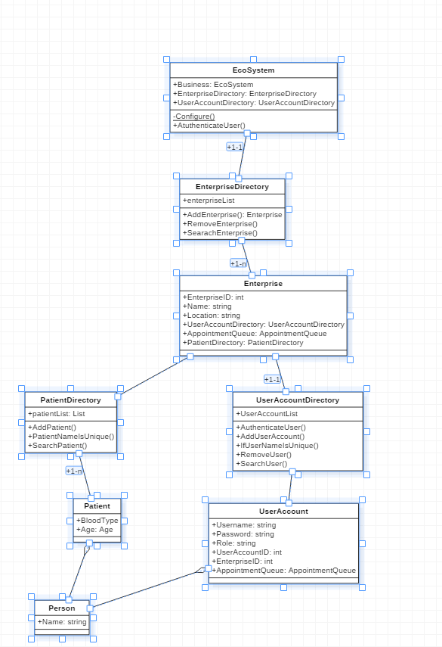

Slide 5
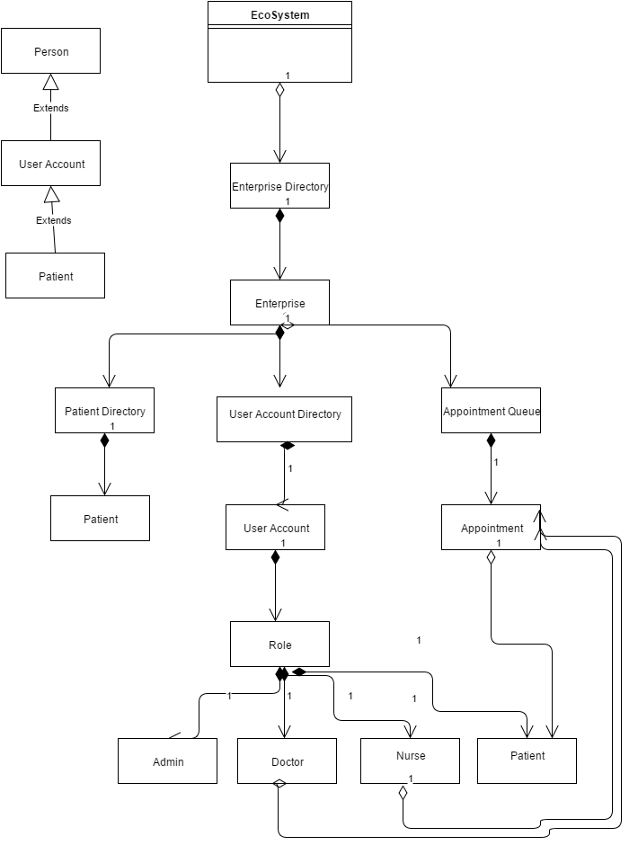

Slide 6
Model-view-viewmodel(MVVM)
The Model-View-ViewModel pattern can be used on all XAML platforms. Its intent is to provide a clean separation of concerns between the user interface controls and their logic.[1]

Slide 7
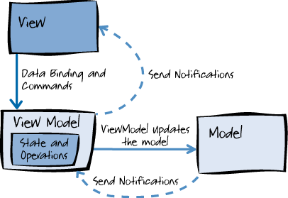
[1]

Slide 8
Reference
[1] Msdn.microsoft.com, 'The MVVM Pattern', 2015. [Online]. Available: https://msdn.microsoft.com/en-us/library/hh848246.aspx. [Accessed: 12- Dec- 2015].

